Slide 1

Career Academy of Business Administration & Management
An Academy of Distinction – with Distinguished Honors
Spring 2025 Town Hall

Slide 2
Today’s Agenda
Course Registration for 2025-2026
CABAM Spring Community Service Project
Mock Interview Day: Tuesday, April 1
College & Career Fair (Thursday, April 17 – 12:45 – 2:30 p.m.)
Professional Dress Day #4 (also Thursday, April 17)
2026 CABAM Business in… Opportunities
  February 14-18, 2026: Business in Seattle
  March 13-22, 2026: Business in Japan (Spring Break)
  June 7-16, 2026: Business in Portugal (Summer)
Summer Career Accelerator Program (SCAP)
Final Student Advisory Committee Meeting – (Thurs. 3/27 2:30 p.m.)
Final Community Advisory Board Meeting (4/14 2:30 p.m.)

Slide 3
What is CABAM?
A career themed academy offering a sequence of courses providing rigorous and relevant content aligned with challenging academic standards and technical knowledge and skills needed to prepare for further education and careers.
CABAM Gives you a head start on life after High School.

Slide 4
CABAM Mission
Empowering Success

Slide 5
CABAM Vision Statement
To provide students with rigorous and relevant business concepts and skills, through education and experiences, that are vital for success in life.

Slide 6
CABAM Values
PRIDE³
  Professionalism
  Results
  Integrity
  Diversity
  Education
  Engagement
  Excellence

Slide 7
CABAM Programs
Digital Information Technology
Hospitality & Tourism Management
Digital Design
Digital Design I*
Business Management & Analysis
Digital Design II
Introduction to Hospitality & Tourism
Technology for Hospitality & Tourism
Legal Aspects of Business
Accounting I
Sports, Entertainment & Recreation Marketing
Sports, Entertainment & Recreation Essentials
Sports, Entertainment & Recreation Applications
Sports, Entertainment & Recreation Management
Hospitality & Tourism Management & Marketing
Hospitality & Tourism Internship
Sports, Entertainment & Recreation Internship
Digital Design III
Business & Entrepreneurial Principles
Computer Science
Advanced Information Technology
AP Computer Science Principles
AP Computer Science A
Digital Design IV
TV Production
Digital Media Technology
Digital media Fundamentals
Digital Media Production
Digital media Delivery
Foundations of Programming

Slide 8
CABAM Standalone Courses
Digital Information Technology
Personal Financial Literacy
Business Education Directed Study
This is a Graduation Requirement for Class of 2027 and later
For Program Completers

Slide 9
Community Service Project
Designed to: Give students opportunities to earn volunteering hours for Bright Futures; teach Corporate Social Responsibility (CSR); and to foster community in the program and school.
Over the past 10 years CABAM Students have raised over $80,000 and volunteered many thousands of hours for several worthy causes.
Keep Florida Beautiful
FEAST
Suncoast Animal Shelter
Palm Harbor Chamber of Commerce
American Cancer Society – Relay for Life

Slide 10
Career & College Fair/Mock Interviews
This event is an opportunity for you to meet with potential employers, and practice networking, filling out job applications, and even interviewing. Many students receive employment or arrange to complete volunteer hours through these events.
Mock Interviews: Tuesday, April 1
Career & College Fair: Thursday, April 17

Slide 11
Professional Dress Day
Professional Dress days allow students to develop an awareness of the image your appearance projects, as well as to learn and practice the finer points of making great first impressions and dressing for success. You will also receive many tips for dressing professionally for special situations like job interviews, business meetings and even business trips.
This is a graded assignment, once per grading period.
  Thursday, April 17

Slide 12
Industry Certifications
Last year More than 125 CABAM students improved their resumes by earning almost 300 globally recognized credentials with a wide variety of certifications. They also helped boost the school grade, and some earned additional college credits and scholarships and even helped earn money for CABAM (Which we spend on them!)
Remaining Certification Dates: 3/13, 3/28, 4/10, 4/24, 5/8, 5/14, 5/23, 5/28

Slide 13

TEDxYouth@PHUHS
Student run TEDxYouth Event
Wednesday, April 23, 2025

Slide 14
Field Trips:
Synapse Summit, Tampa: March 25
Hyatt Regency Clearwater Beach: Wednesday, April 30
“Business in…Seattle” February 2026 (5 days)
“Business in…Japan!” March 2026 (Spring Break 9 days!)
“Business in…Portugal” Summer 2026
FBLA National Conferences:
  2025: Anaheim, CA
  2026: San Antonio, TX
  2027: Nashville, TN
  2028: Columbus, OH

Slide 15
Career Academy of Business Administration and Management
-A C.A.P.E Academy
- An Academy of Distinction with Distinguished Honors
Summer Career Acceleration Program 2025
Program starts on June 2nd and ends on July 3rd
Must be 16 years old or older by June 2nd
Must have access to transportation
$15 per hour
Up to 20 hours per week, hours will be determined on an individual basis
Includes career readiness and financial literacy workshops
Funding is limited; students’ eligibility will be determined on a first-come, first-served basis
Email resumes by March 7th
"Empowering Success"

Slide 16
CABAM Student Advisory Committee
Are you a passionate and driven student interested in shaping the future of our Business Program while earning valuable volunteer community service hours? Here's your chance to make a real impact and pave the way for positive change!
The Student Advisory Committee is a unique opportunity for dedicated students to have a direct say in the development and enhancement of CABAM, including the programs we offer, curriculum we utilize, the activities we participate in, and the causes we get involved in. Your insights, ideas, and feedback will help us create an even more engaging and enriching learning experience for all CABAM students.
Thurs. 3/27 2:30 p.m.
See Mr. Schachter with questions

Slide 17
Community Advisory Board
A group of Business Partners, business owners & managers, entrepreneurs, parents, teachers, and students who assist in adding value to what we are able to offer you, by organizing the programs discussed, offering job shadow opportunities, internships, mentoring and more.
Final Meeting – Monday, April 14, 2:30 p.m.

Slide 18
Incentives for active student engagement in CABAM courses and activities:
Grad Cords for Program Completers
T-Shirts
Prizes, Gift Cards/Certificates, Swag
Scholarships (Gold Seal/Bright Futures)
  The Tim & Susan Bryce Scholarship $1,000
College Credit (SPC)
Reduced Cost on Field Trips
& More to come!

Slide 19
CABAM Staff
Kevin Schachter | schachterk@pcsb.org | Accounting Applications I & II, Digital Information Technology, Legal Aspects of Business, Business & Entrepreneurial Principles, Introduction to Hospitality & Tourism, Technology for Hospitality & Tourism, Hospitality & Tourism Marketing Management, Hospitality & Tourism Internship, Business Ed. Directed Study. ***Future Business Leaders of America(FBLA), ***Technology Coordinator/phuhs.org Webmaster, ***Department Chair
Dzindzi Asamoah-Wade | asamoahwaded@pcsb.org | Advanced Information Technology, Foundations of Programming, AP Computer Science Principles, AP Computer Science A, ***National Technical Honor Society, ***Girls Who Code
Kay Knox | knoxb@pcsb.org | Digital Information Technology; Digital Design I-IV; TV Production (Digital Media Technology)
Randy Homa | homar@pcsb.org | Sports, Recreation & Entertainment Marketing I – III: Personal Finance

Slide 20
Career Academy of
Business Administration & Management
Text to 81010 for CABAM Reminders
Grade 9: @CABAM28
Grade 10: @CABAM27
Grade 11: @CABAM26
Grade 12:@CABAM25
Like us at facebook.com/cabamphuhs/

Slide 21

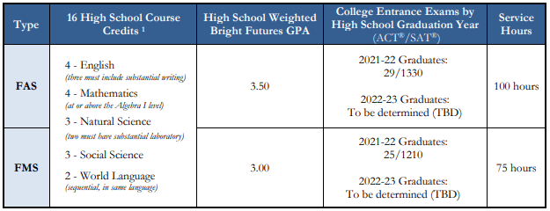

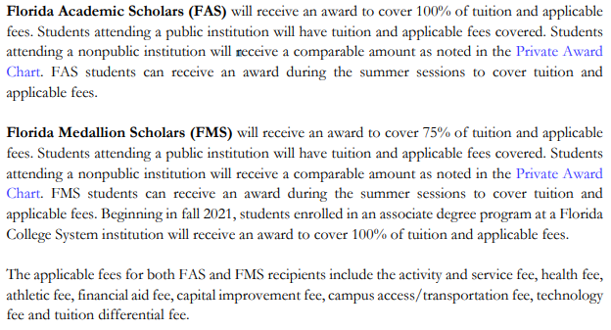
Academic and Medallion Scholarships
Type | High School Course | HS GPA | ACT / SAT Scores | Service Hours | Award
FAS | 4 – English 4 – Mathematics 3 – Natural Science 3 – Social Science 2 – World Language | 3.50 | 2021–22 Graduates: 29 / 1340 2022–23 Graduates: TBD | 100 hours | 100%
FMS |  | 3.00 | 2021–22 Graduates: 25 / 1210 2022–23 Graduates: TBD | 75 hours | 75%
Bright Futures
Source: https://www.floridastudentfinancialaidsg.org/SAPBFMAIN/SAPBFMAIN

Slide 22
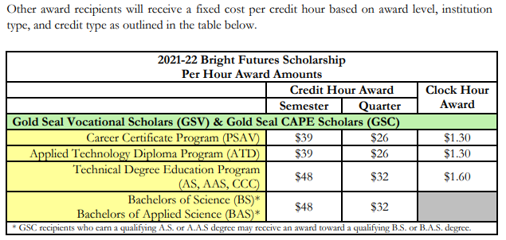
Gold Seal: Vocational (GSV) or CAPE (GSC)
GSV and GSC award recipients will receive a fixed cost per credit hour based on award level, institution type, and credit type as specified in the BF Student Handbook, chapter 2.
Gold Seal awards (GSC/GSV) may only be used at postsecondary institutions that offer an applied technology diploma, technical degree education program (associate in science-A.S. or associate in applied science-A.A.S.), or a career certificate program. GSC recipients who earn a qualifying A.S. or A.A.S. degree may be funded for a qualifying B.S. or B.A.S. bachelor’s degree.
Bright Futures
Notes:
Questions for BF:
Do the CAPE certifications have to be from the same Associate Degree Program? No, they just need the articulated credit.
Does the student have to be enrolled in the Associate Degree program that aligns with their certifications? No
How is this impacted with dual enrollment? No impact if student is enrolled in HS and earns certification.
Can the certifications be earned in middle school? [assuming yes, but confirm with Timberly]

Slide 23


Slide 24
Articulated Certifications (examples)
This list is only a few of the CAPE certifications that have articulated credit.
FDOE Cert. Code | Certification Title | # of Credits Articulated
ADOBE023 | Adobe Certified Professional in Video Design (Requires Premiere Pro and After Effects or Photoshop) | 4
ADOBE024 | Adobe Certified Professional in Visual Design (Requires Photoshop and Illustrator or InDesign) | 3
AIOPB001 | Certified Bookkeeper | 3
PROSO003 | Certified Internet Web (CIW) E-Commerce Specialist | 3
PROSO017 | Certified Internet Web (CIW) JavaScript Specialist | 3
COMPT007 | CompTIA Project+ | 3
COMPT008 | CompTIA Security+ | 3
ICOEC005 | EC-Council Cyber Forensics Associate | 3
ICOEC006 | EC-Council Ethical Hacker Associate | 3
MICRO089 | Microsoft Certified Solutions Expert (MCSE) - Data Platform | 3
MICRO069 | Microsoft Office Specialist (MOS) Bundle Certification (3 of 6) | 3
MICRO017 | Microsoft Office Specialist Master | 3
MICRO080 | Microsoft Technology Associate (MTA) - HTML5 Application Developer Fundamentals | 3
MICRO104 | Microsoft Technology Associate (MTA) - Introduction to Programming Using JavaScript | 3
MICRO112 | Microsoft Technology Associate (MTA) - Introduction to Programming Using Python | 3
INTUT001 | QuickBooks Certified User | 3
UNITY001 | Unity Certified Associate | 6
UNITY002 | Unity Certified User: Programmer | 6
Bright Futures – Gold Seal CAPE
Eligible CAPE Certifications: Active Articulation Agreements Summary www.fldoe.org/core/fileparse.php/7525/urlt/active-articulation-summary.xlsx

Slide 25
Through the articulation agreement with St. Petersburg College, students will earn college credit if specified criteria are met.
For current course articulation and requirements, visit www.spcollege.edu/connect; select Pinellas County High School – Academy College Credit.
Each PCS high school’s CTE program is listed with the applicable SPC articulation.
SPC articulation is subject to change.
SPC Articulation

